Slide 1
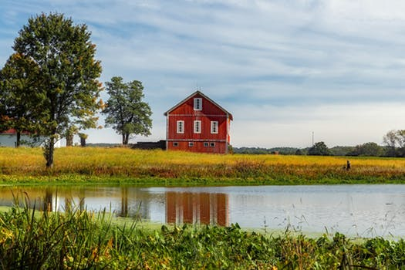

Water For Agriculture
Creating an Engaged Approach to Water For & From Agriculture
WATER for AGRICULTURE
NACDEP Annual Conference, June 11, 2018
Cleveland, Ohio
Walt Whitmer, Project Coordinator, Co-PI
Kathy Brasier, Professor of Rural Sociology, PI
Weston Eaton, Assistant Research Professor, Co-PI
Elyzabeth Engle, Assistant Professor, Environmental Studies, Co-PI

Slide 2
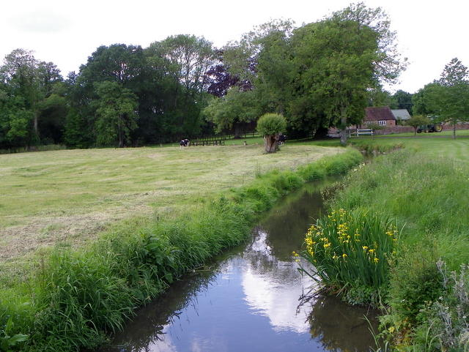
What We’ll Talk About
Project Overview
Core Elements of Stakeholder Engagement
Research Methodologies
Organizing Our Efforts

Slide 3
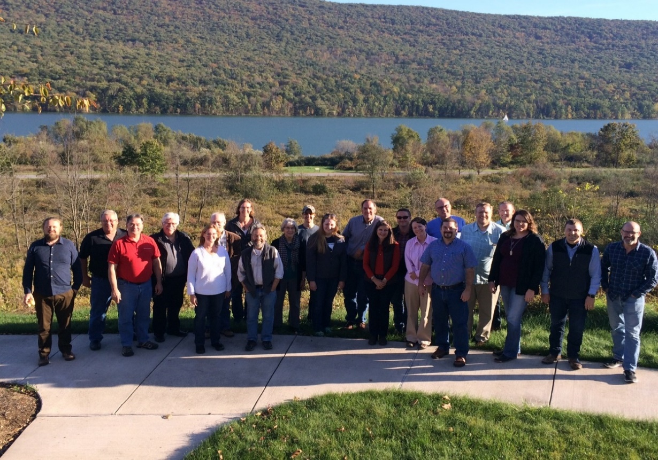




What Is Water for Agriculture?
A multi-disciplinary, four-year cooperative project that…
Brings together social and biophysical researchers and practitioners
Promotes sustainable water for agriculture through the development of an evidence-based approach to stakeholder engagement
This work is supported by the Agriculture and Food Research Initiative (AFRI) Water for Agriculture grant no. 2017-68007-26584/project accession no. 1013079 from the USDA National Institute of Food and Agriculture.

Slide 4
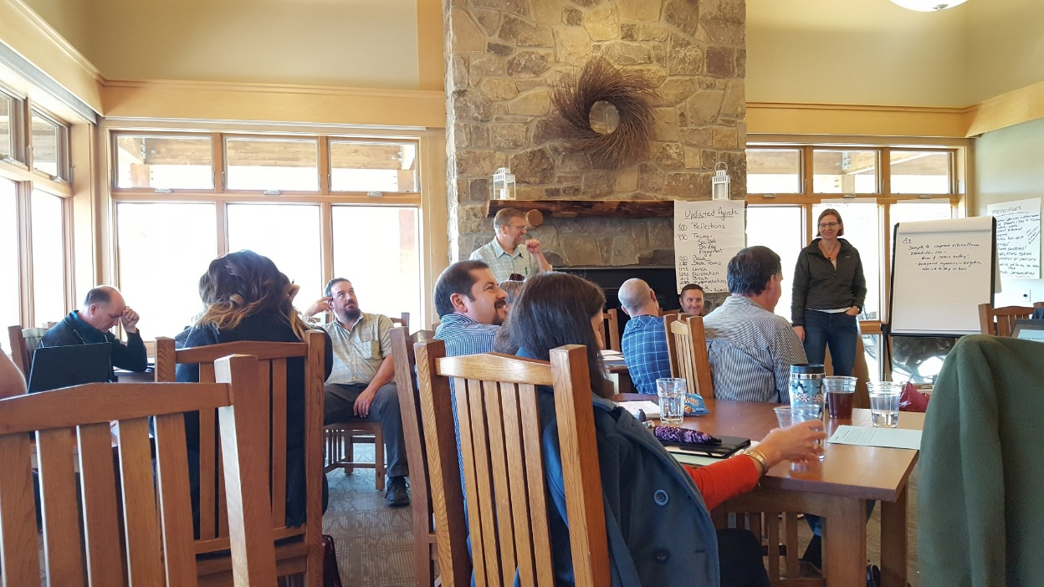
Our Purpose
To better understand the processes by which:
A broad range of stakeholders can come together to better address the water and agricultural issues most important to them – and what changes socially and environmentally because of their efforts

Slide 5
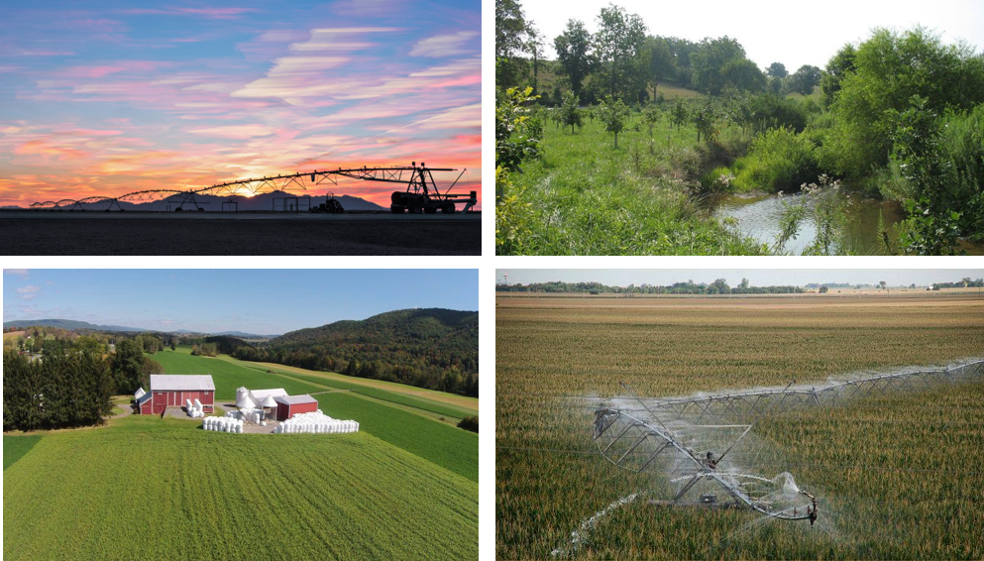
Our Goals
Work in cooperation with, and in service to four communities in Pennsylvania, Nebraska and Arizona
Assist these communities in addressing the water and agricultural issues that matter most to them
Develop an evidence-based approach to stakeholder engagement
Assess whether and how this approach can help these communities and others address critical water and agriculture issues

Slide 6
Project Timeline
YEAR ONE – PRELIMINARY RESEARCH | YEARS TWO AND THREE – STRUCTURED ENGAGEMENT PROCESSES | YEAR FOUR – FINAL ASSESSMENT/IMPACTS
Literature reviews | Relationship building and trust | Social network analysis (Post)
Conceptual Model development | Review of current networks and biophysical data | Stakeholder interviews (30-40/site)
Stakeholder identification | Issues identification | Community surveys (Post)
Social network analysis (Pre) | Assess Information/research needs and opportunities | Assess practice, policy and environmental change
Stakeholder interviews (30-40/site) | Priority setting & implementation plan
Community surveys (Pre) | Engagement plan
Identify preliminary biophysical data sources and needs | Implementation activities, action research
 | Formative and Process Evaluation

Slide 7
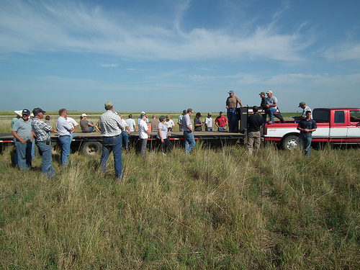
Working Definition: Stakeholders
All those who either can affect, or will be affected by a decision or initiative
Farmers, producers, and ag businesses
Ag organizations
Community and interest organizations
Regulatory agencies
Service and information providers
Researchers
Local governments
Landowners and other residents

Slide 8
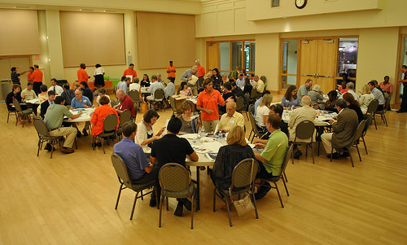
Working Definition: Community Engagement
An approach to decision-making and participation that is…
Integrated
Proactive
Reciprocal
Relationship building

Slide 9
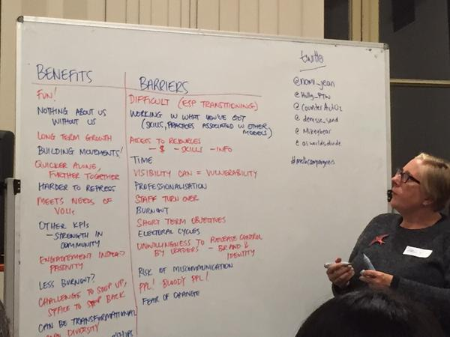
Engagement Approaches
PA and NE – modified strategic planning and implementation process driven by local leaderships teams (two-years)
Local leadership teams comprised of a broad representation of key stakeholders groups (8-15 per site)
AZ – modified one-year Delphi Technique. Initial community meeting followed by iterative problem and solution identification surveys and discussions with a panel of local experts (broadly defined)

Slide 10
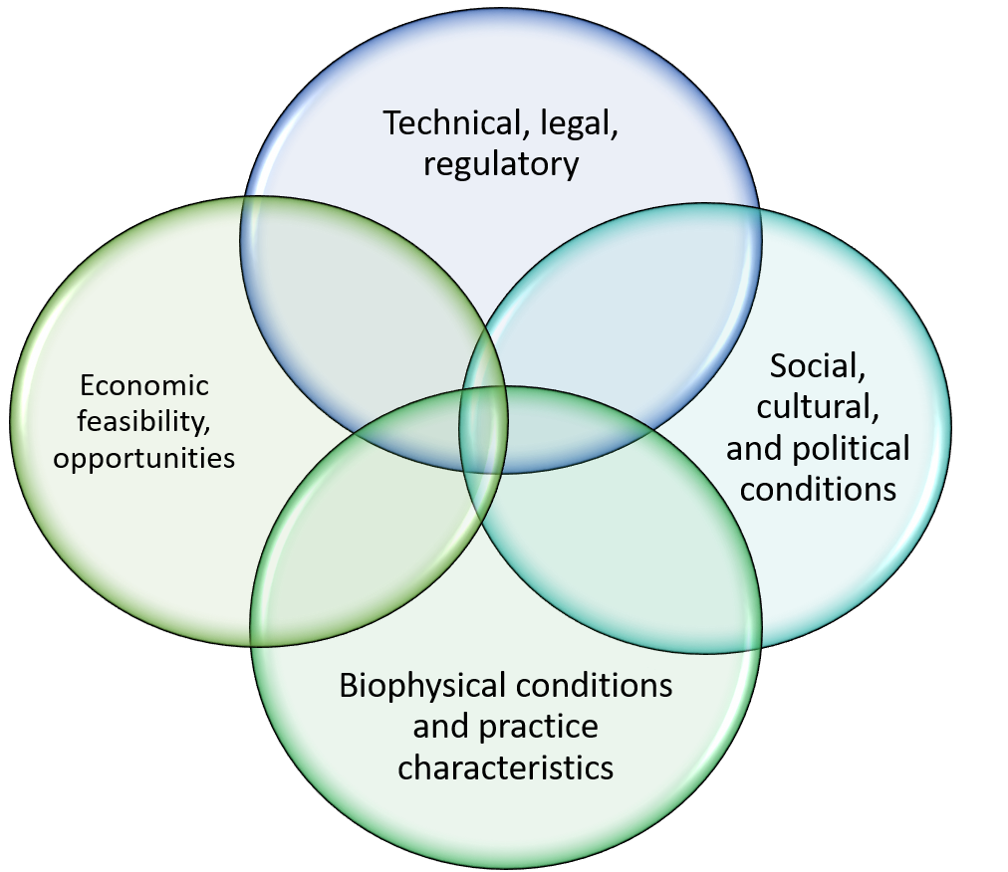
Core Process Objectives
Building relationships and trust
Identifying perspectives, issues and priorities
Assessing and fostering community capacity building
Developing an implementation plan
Developing engagement and communications plans
Implementation
Evaluation – formative and process

Slide 11
What Constitutes Engagement?

Slide 12
Engagement Process Goals & Metrics
IAP2 | Strategies | Metrics
Inform | Getting to know one another, identifying project scope, why do this, broadening the tent. Sharing of SNA findings, sharing key environmental, water and ag data | Network awareness, capacity building, KASI
Involve | Building awareness of current network, identification of team expectations, strategies, organizing goals and principles, communications expectations and collaborative processes | KASI, Trust, collective identity, role & expectations, relationships, efficacy
Consult | Exploring current programs, impacts, resources and activities | KASI, Trust, collective identity, role & expectations, relationships
Collaborate | Identifying key needs, priorities and strategies. Developing an implementation plan. Developing general population survey and engagement plans. Identifying key capacity-building priorities (social and biophysical, individual and group) | Issues identification, plan development and implementation, KASI, Trust, collective identity, role & expectations, relationships
Empower | Data provision, biophysical research, action research, leadership capacity, group and community workshops, sustainability plan, collaborative evaluation | Implementation plans, KASI, rust, collective identity, role & expectations, relationships

Slide 13
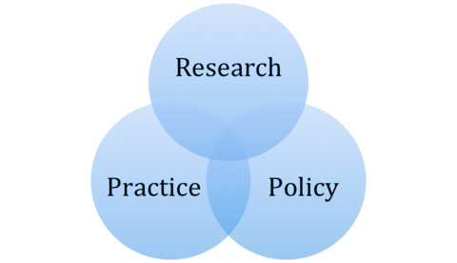
Shared Research and Practice Approach
Documented value in the literature
Important but incomplete insights into motivations, structures, processes, goals, efficacy and duration
Process guidance and implementation guidance
Limited research/practice re: agriculture and water

Slide 14
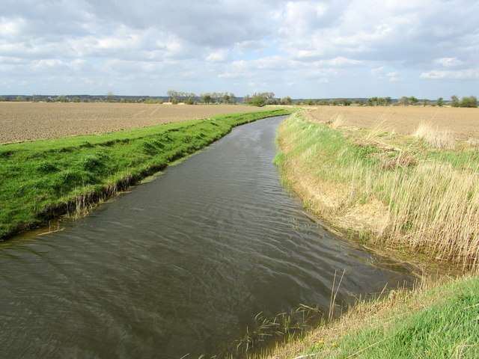
Research Approach
Longitudinal comparative case study investigating changes as a result of structured engagement approaches relative to:
social indicators (attitudes, trust, networks, collaboration, participation, efficacy etc.) and
biophysical conditions (practice change, projects, water quality and/or quantity)

Slide 15
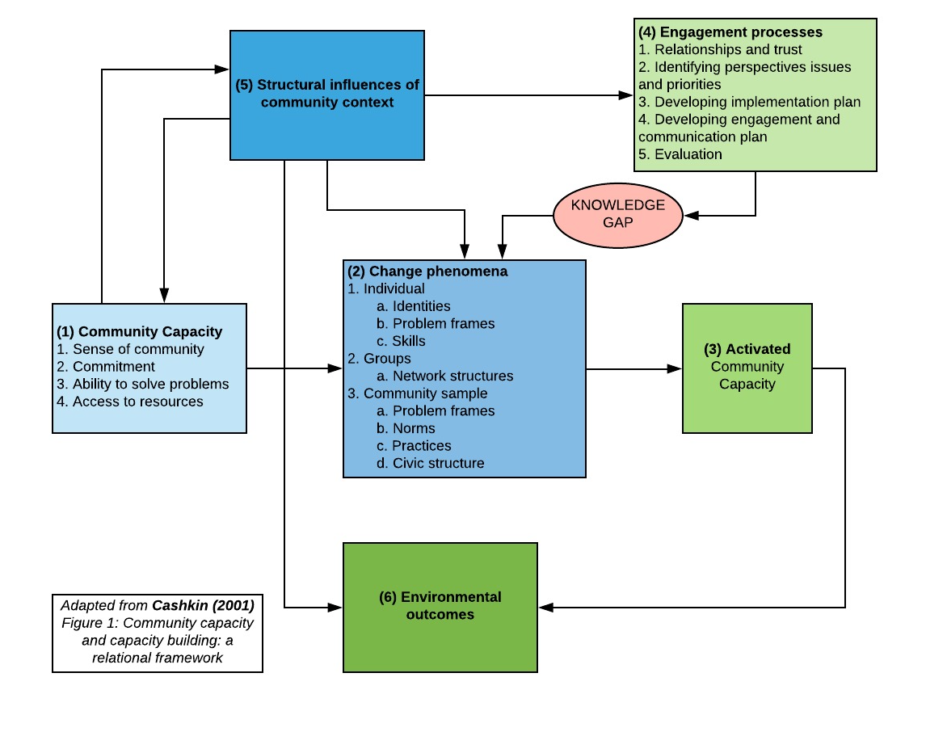
Conceptual Framework

Slide 16
Guiding Research Questions
What change in views, understandings, personal norms, personal and collective identity, and skills may be evident in individuals who participate in engagement activities?
  Interview and other qualitative data, field observation, formative and process evaluations
What change, if any, becomes evident with characteristics of network structures for organizations participating in engagement activities?
  Social Network Analysis, field observation, formative and process evaluation
What attitudinal, belief, or behavioral changes are evident in communities where engagement activities are undertaken?
  Community Surveys, workshop evaluations, field observations

Slide 17

What We’ve Learned (so far) about working as a Multi-Disciplinary Team
Inter and cross-team communication is critical
Language matters
Distance has its limitations/F2F matters
Communication is key – as well as the nature and timing of it
Working principles and guidelines are important

Slide 18
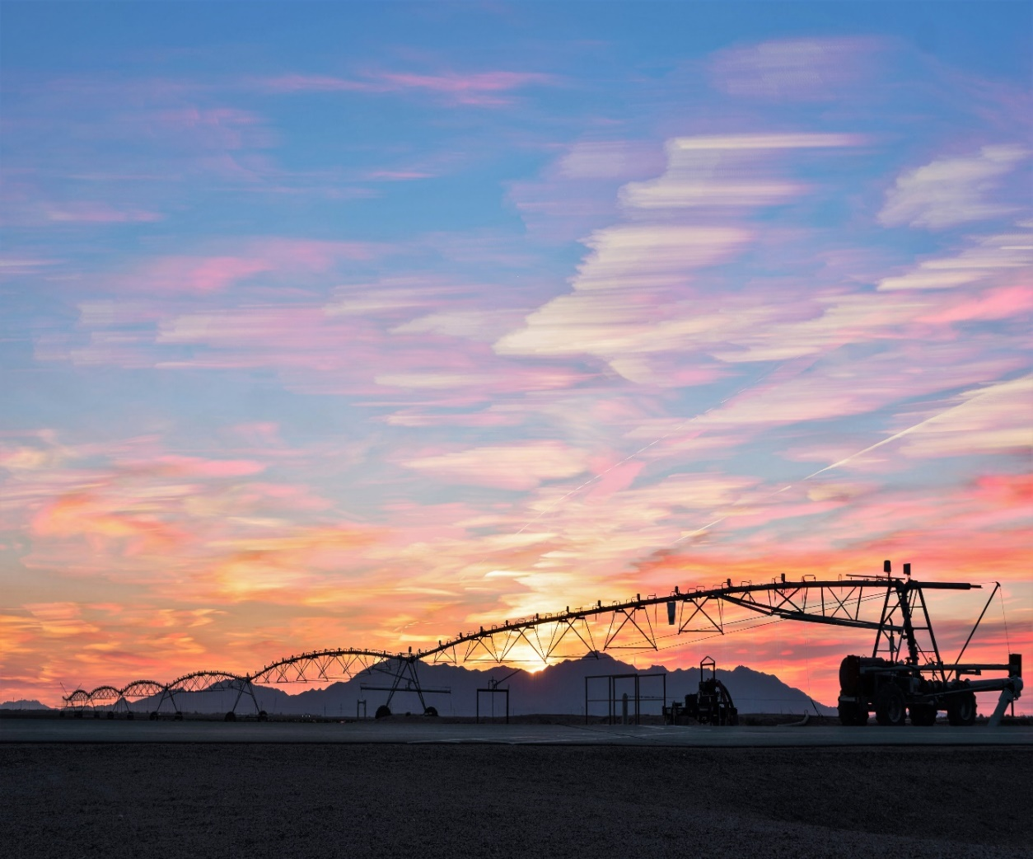
Contact
Walt Whitmer,
Department of Agricultural Economics, Sociology and Education
Penn State University
814-865-0468
wew2@psu.edu
http://water4ag.psu.edu/

