Slide 1

Demographic Trends:
Consequences for Community Development
Presented by Don E. Albrecht
Western Rural Development Center
NACDEP Webinar
April 15, 2020

Slide 2
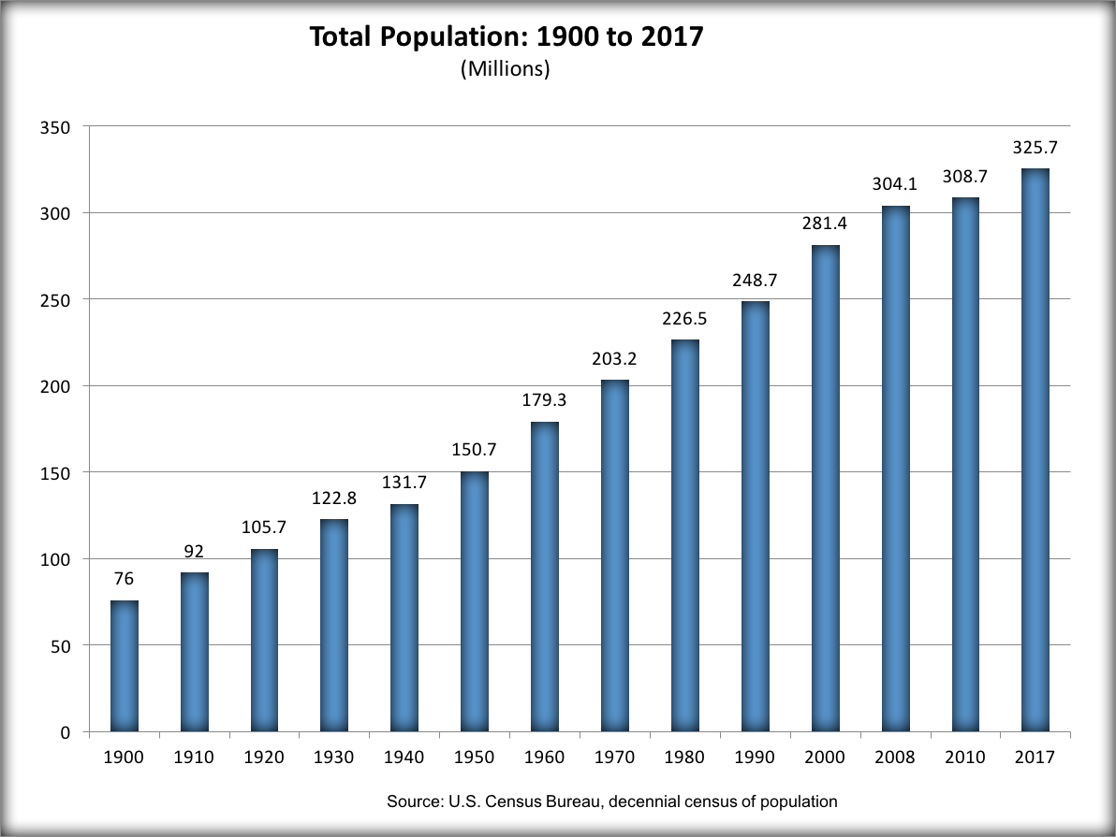
TOTAL Population
NACDEP Webinar – April 15, 2020

Slide 3
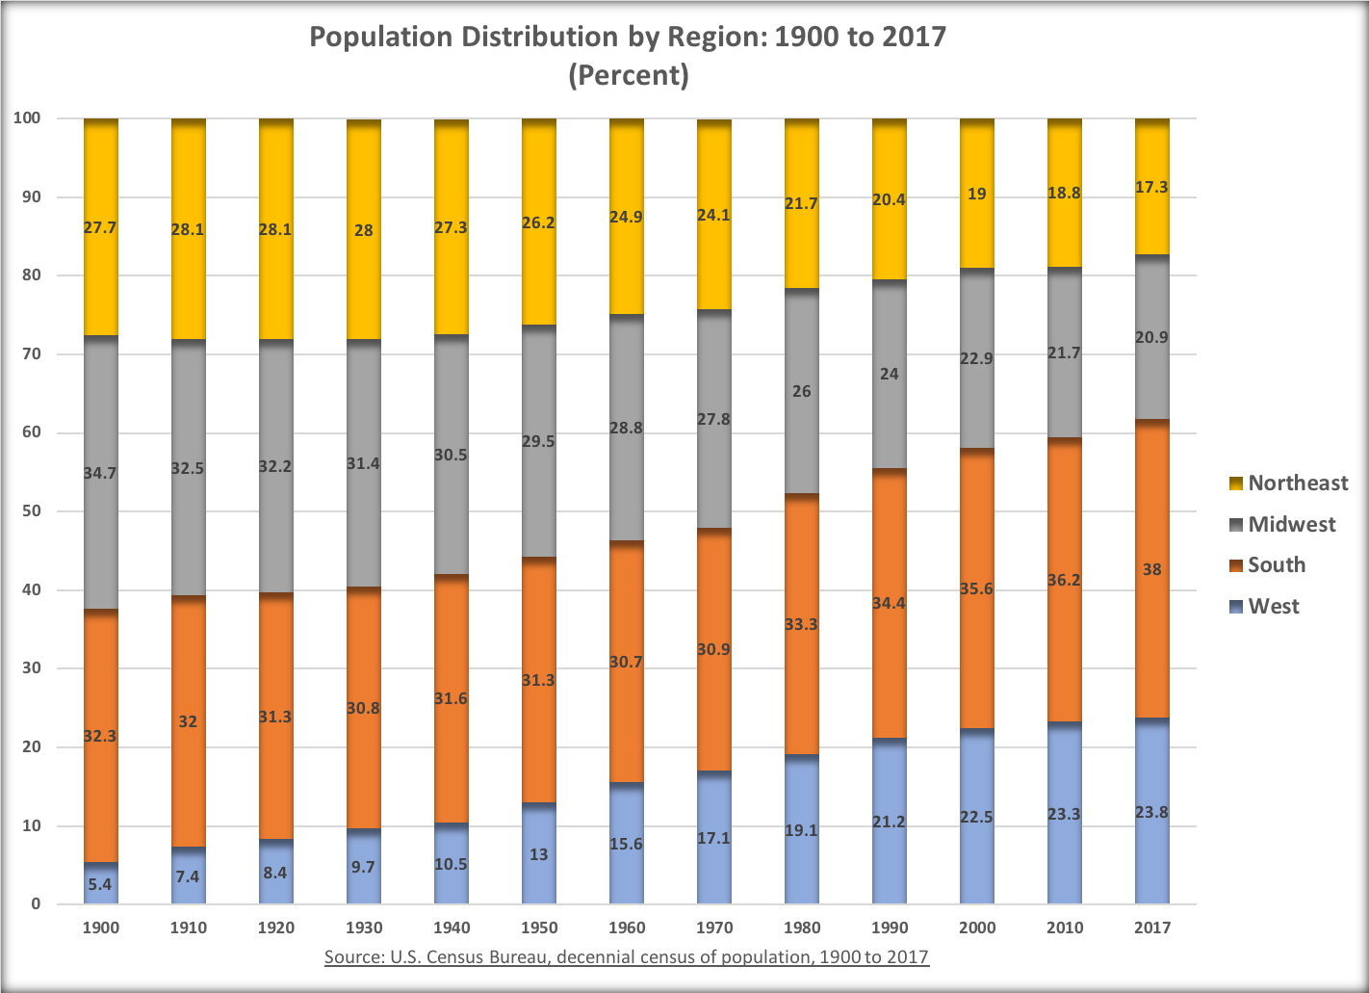
POPULATION Distribution by Region
NACDEP Webinar – April 15, 2020

Slide 4
POPULATION CHANGE by State
Population Change by State 2000-2018
Nevada | 54.1 | Maryland | 14.4
Utah | 43.6 | Nebraska | 13
Arizona | 41.9 | Arkansas | 12.9
Texas | 39.1 | Indiana | 10.7
Idaho | 38.5 | Kentucky | 10.5
Florida | 34.4 | Alabama | 10.3
Colorado | 33.9 | New Hampshire | 10
North Carolina | 30.3 | Missouri | 9.7
Georgia | 29.7 | Massachusetts | 9.5
Washington | 29.2 | Wisconsin | 8.6
South Carolina | 28.3 | Kansas | 8.4
Delaware | 24.3 | Iowa | 7.8
District of Columbia | 23.4 | New Jersey | 5.6
Oregon | 23.3 | Maine | 5.4
Virginia | 20.6 | Connecticut | 4.7
Tennessee | 20.1 | Mississippi | 4.6
North Dakota | 18.7 | Louisiana | 4
Montana | 18.5 | Pennsylvania | 3.4
South Dakota | 17.2 | Illinois | 3.3
Wyoming | 17.2 | Ohio | 3
Hawaii | 16.9 | New York | 2.5
California | 16.7 | Vermont | 2.5
Alaska | 16.7 | Rhode Island | 1.1
New Mexico | 15.3 | Michigan | 0.5
Oklahoma | 14.7 | West Virginia | -0.5
Minnesota | 14.6
NACDEP Webinar – April 15, 2020

Slide 5
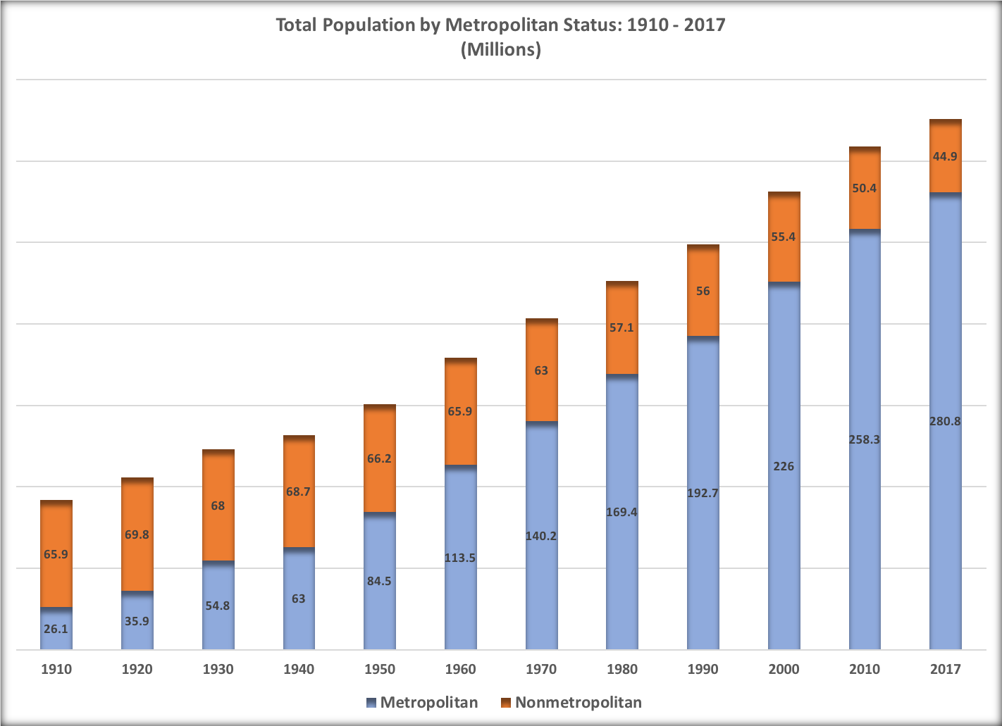
TOTAL POPULATION by Metro Status
NACDEP Webinar – April 15, 2020

Slide 6
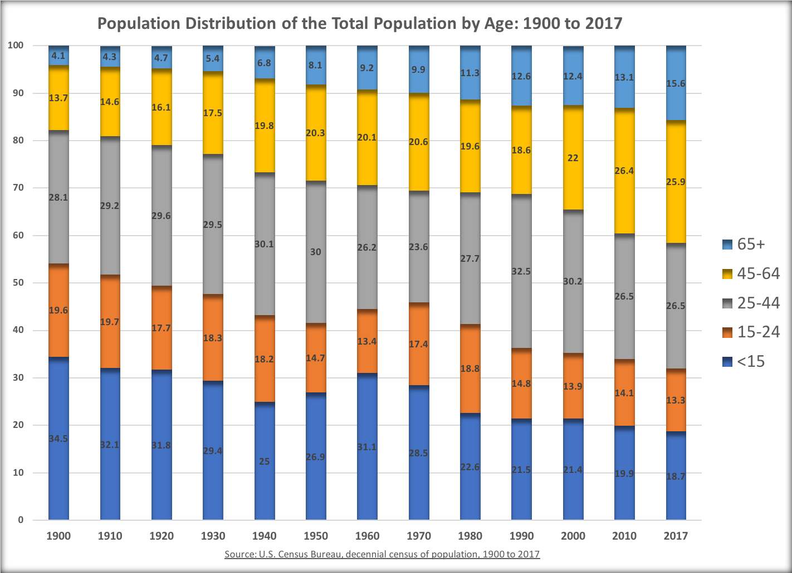
TOTAL POPULATION by Age
NACDEP Webinar – April 15, 2020

Slide 7
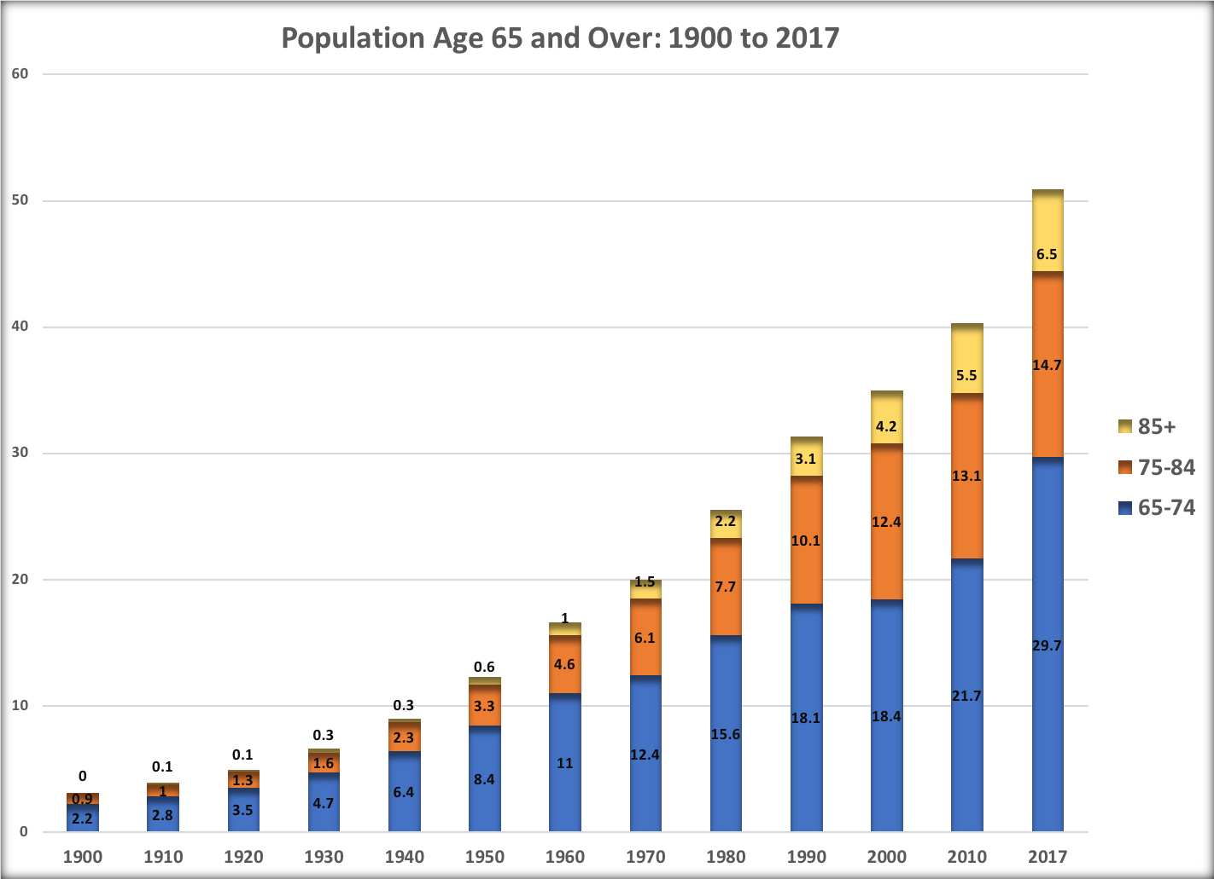
POPULATION Age 65 and over
NACDEP Webinar – April 15, 2020

Slide 8
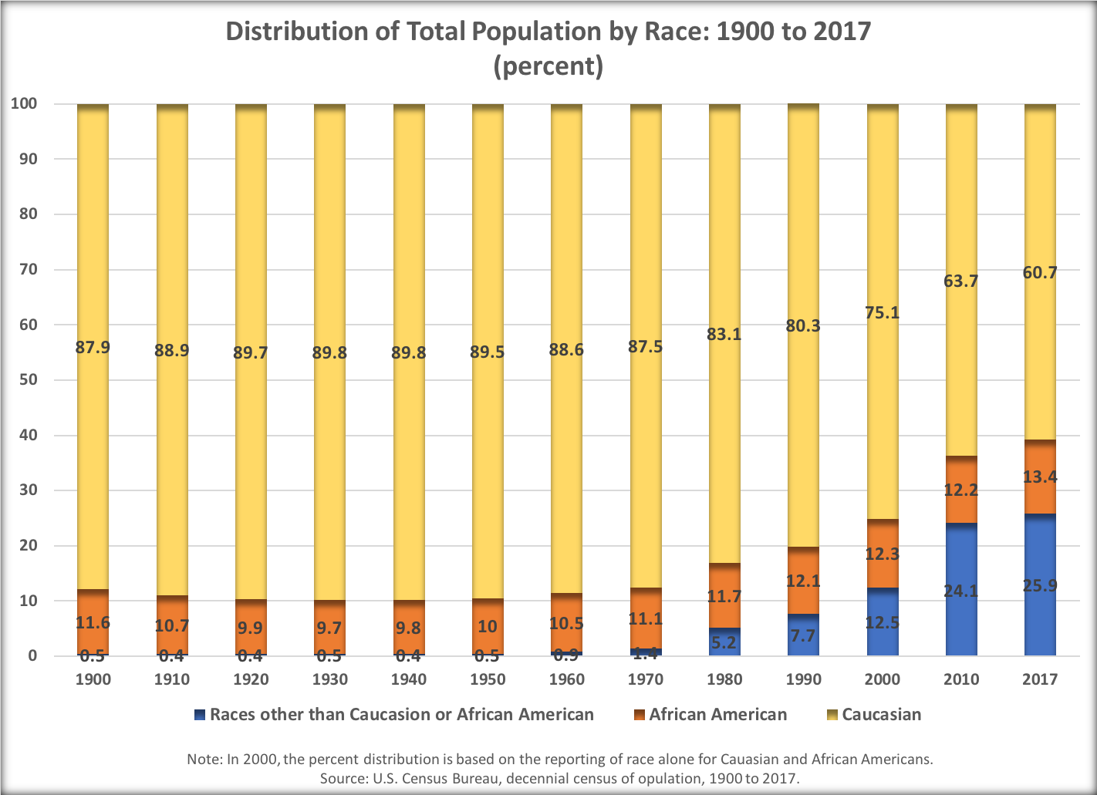
POPULATION by Race
NACDEP Webinar – April 15, 2020

Slide 9
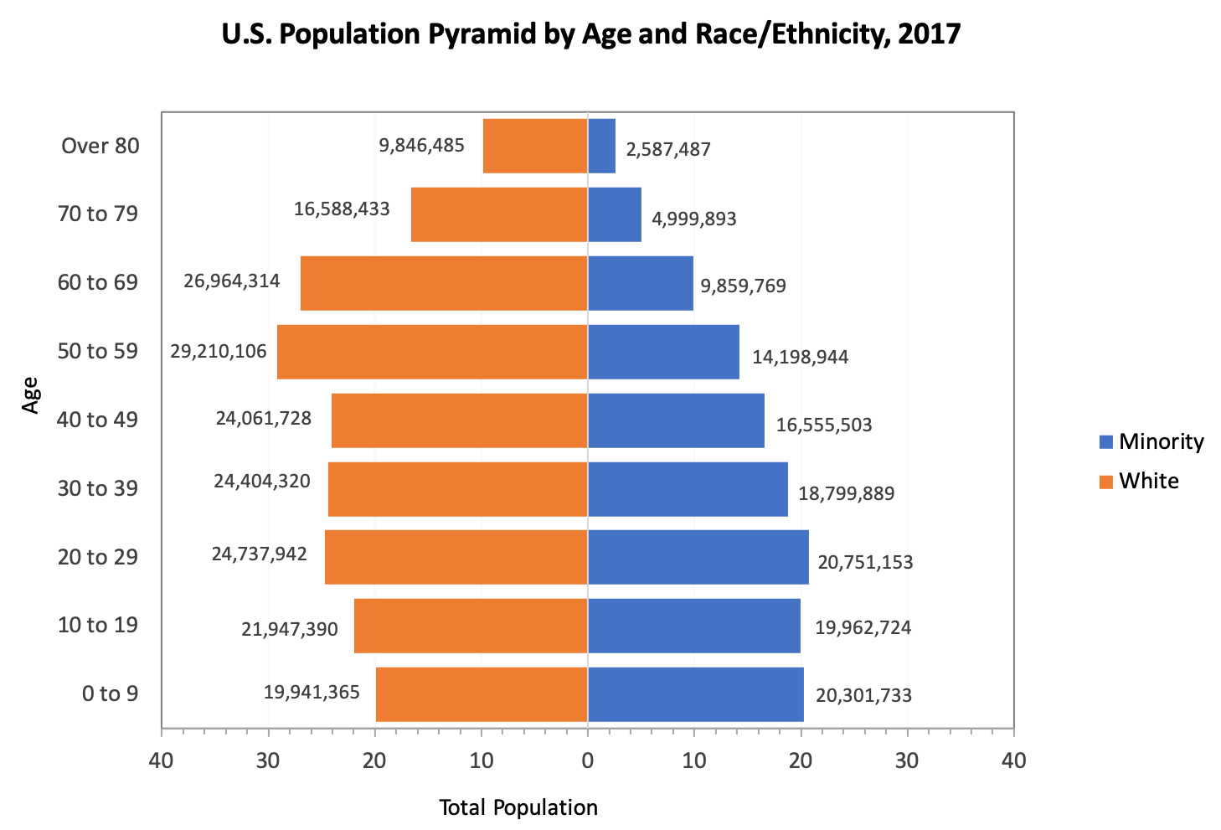
POPULATION by Race
NACDEP Webinar – April 15, 2020

Slide 10
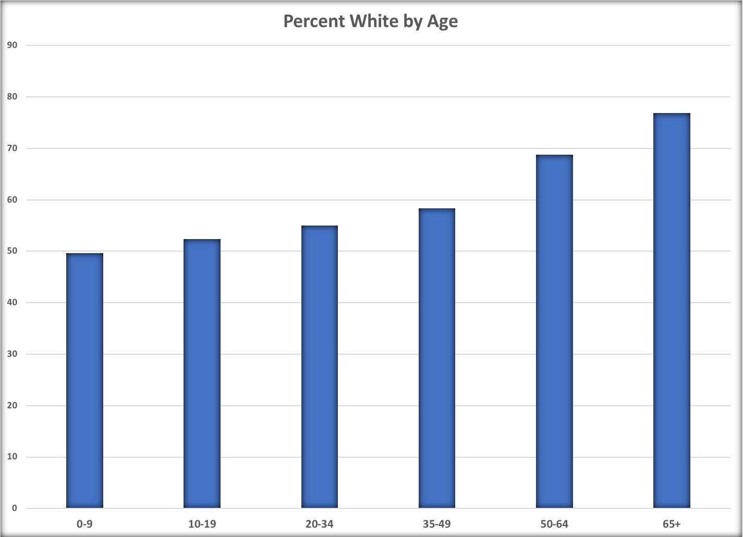
PERCENT White Population by Age
NACDEP Webinar – April 15, 2020

Slide 11

WHITE POPULATION Declined
In 2016 and 2017,
the White population
in the United States
declined.
NACDEP Webinar – April 15, 2020

Slide 12
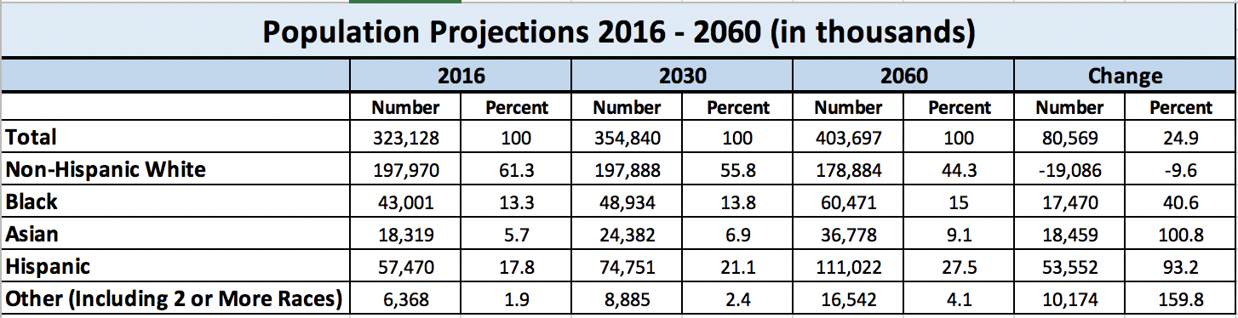
POPULATION Projections
NACDEP Webinar – April 15, 2020

Slide 13
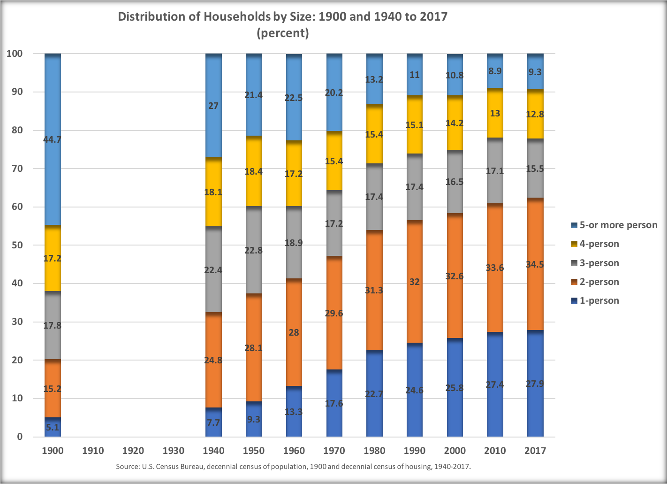
DISTRIBTUION of Household by Size
NACDEP Webinar – April 15, 2020

Slide 14
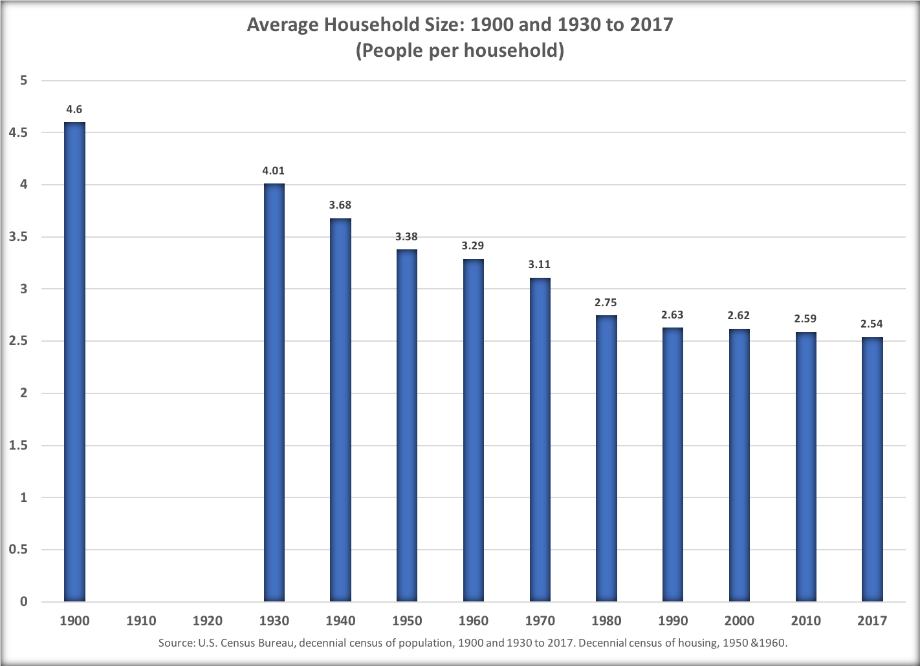
AVERAGE Household Size
NACDEP Webinar – April 15, 2020

Slide 15
AGE at First Marriage
NACDEP Webinar – April 15, 2020

Slide 16
FERTILITY Rate
NACDEP Webinar – April 15, 2020

Slide 17
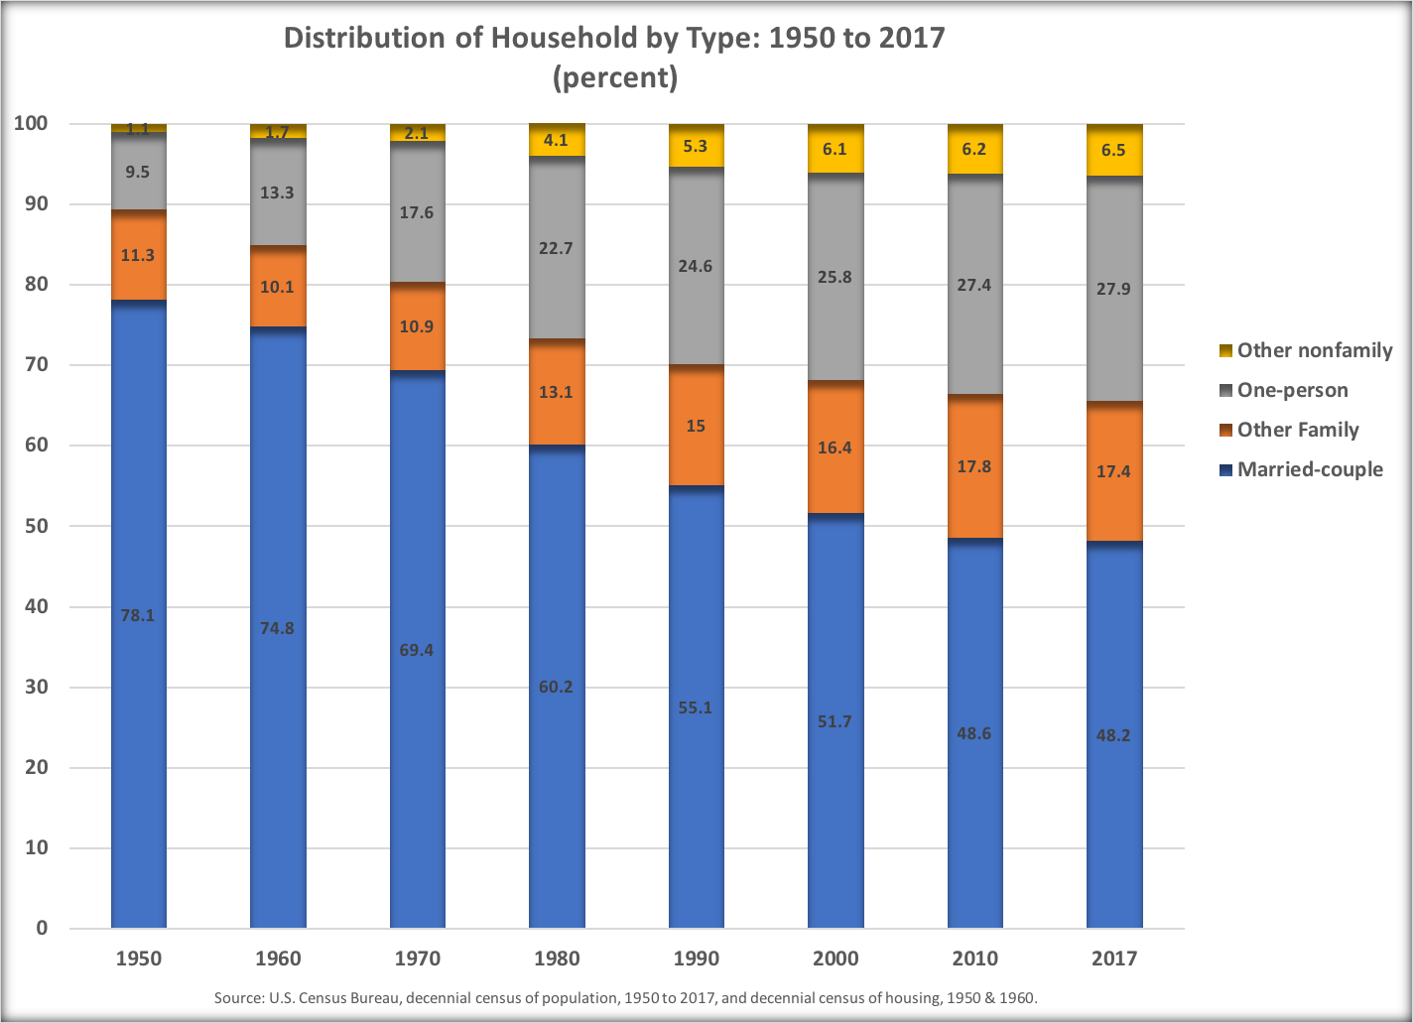
DISTRIBUTION of Household by Type
NACDEP Webinar – April 15, 2020

Slide 18
MEDIAN EARNINGS Full Time, Year Round
NACDEP Webinar – April 15, 2020

Slide 19
INCOME 1973-2018
NACDEP Webinar – April 15, 2020

Slide 20
INCOME 1973-2018
NACDEP Webinar – April 15, 2020

Slide 21
INCOME by Education
NACDEP Webinar – April 15, 2020

Slide 22
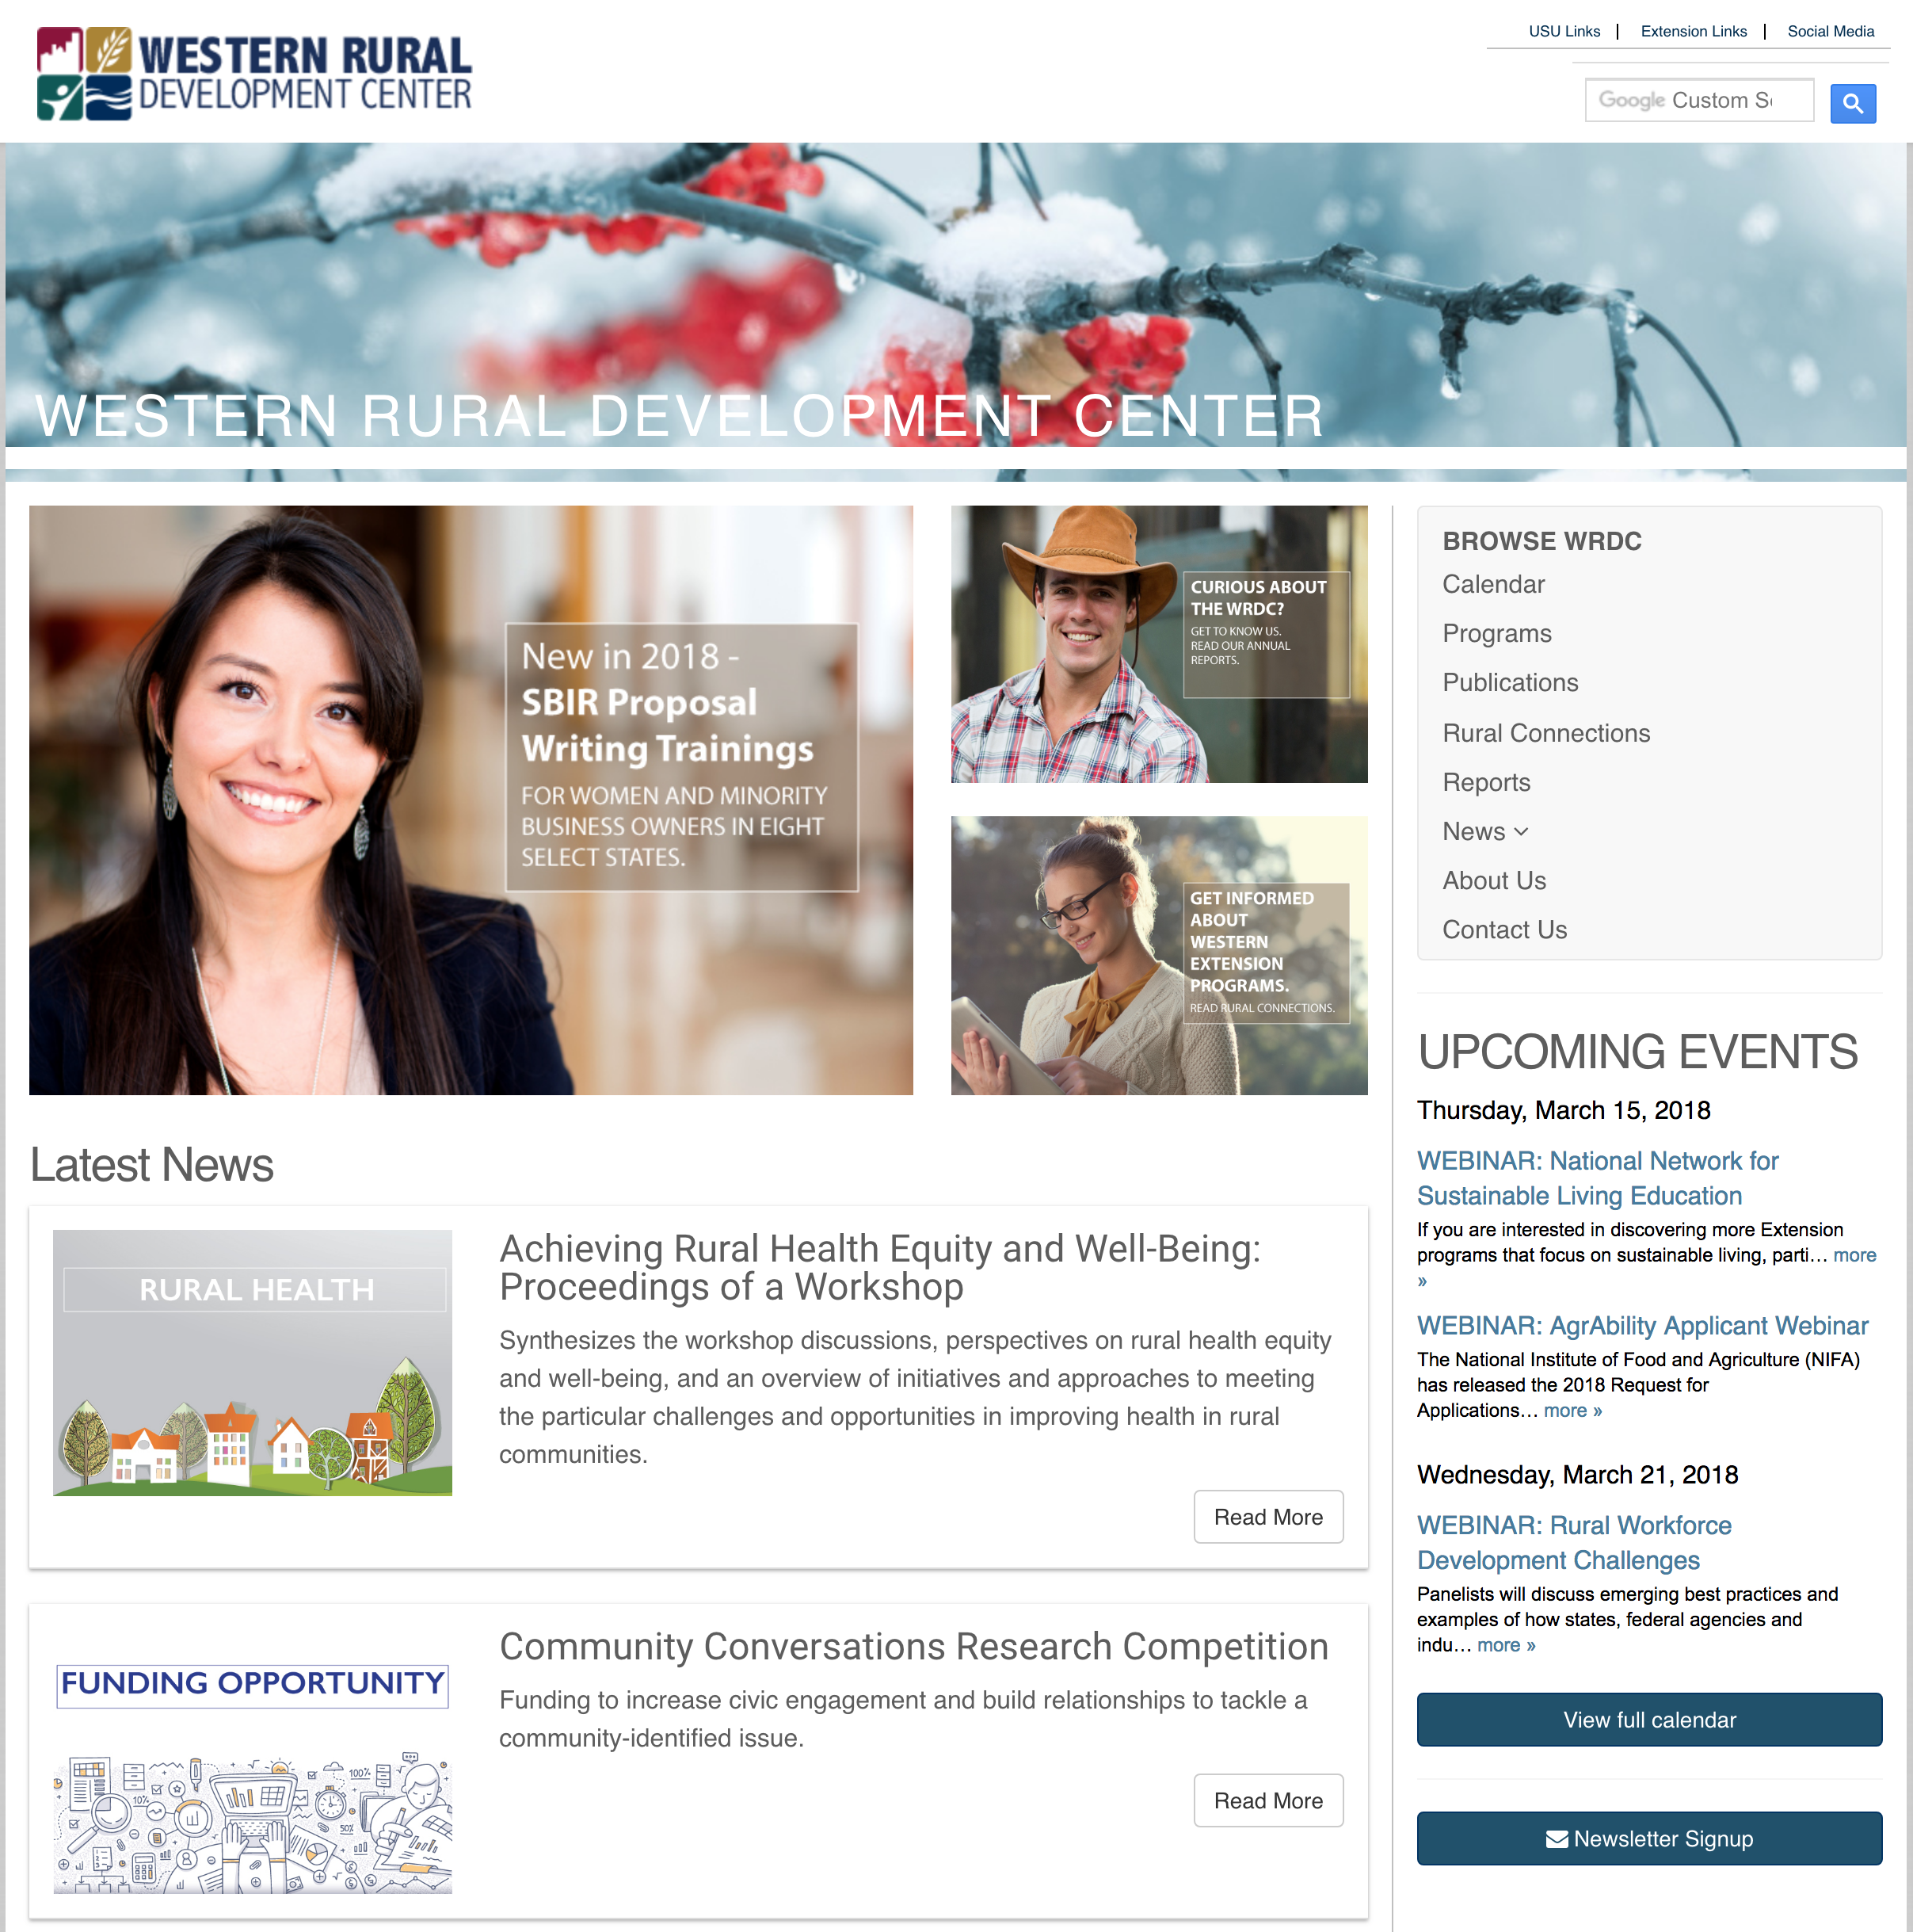
WRDC Contacts
Don E. Albrecht
Director
Western Rural Development Center
Utah State University
Tel: 435.797.2798
Email: don.albrecht@usu.edu
Betsy H. Newman
Assistant Director
Western Rural Development Center
Utah State University
Tel: 435.797.0218
Email: betsy.newman@usu.edu
Connect
Visit our website wrdc.usu.edu for:
  Calendar of events
  Publications
  News
  Program Details
The Western Rural Development Center assists rural communities through its
Extension network so they may prosper, thrive economically, and become self-sustaining.
wrdc.usu.edu

